Slide 1

웹 프로그래밍
한글과컴퓨터학원
조교 이서현

Slide 2
장고
django-admin startproject helloworld

Slide 3
장고
django-admin startapp youtuber

Slide 4
장고
helloworld/settings.py
INSTALLED_APPS = [
'django.contrib.admin’,
'django.contrib.auth’,
'django.contrib.contenttypes’,
'django.contrib.sessions’,
'django.contrib.messages’,
'django.contrib.staticfiles’,
'main’,
]

Slide 5
장고
python manage.py runserver

Slide 6
MVC 패턴
컨트롤러
뷰
모델
생성
조회
수정
브라우저

Slide 7
MVC 패턴
모델
컨트롤러
뷰
데이터 저장
입력 처리
뷰 업데이트
모델 쿼리
예쁘게
보여줌

Slide 8
MVC 패턴
모델
컨트롤러
뷰
model.py
views.py
*.html

Slide 9
장고
모델
뷰
템플릿
model.py
views.py
*.html
관리자
라우팅
admin.py
urls.py

Slide 10
라우팅
main
path(‘main/', include('main.urls'))
helloworld/main/
views.py: index
path(‘hi', views.index, name='index')
helloworld

Slide 11
라우팅
path(‘<int:pid>/result’, …)
<형식:변수>
str – 문자열(/ 제외)
path – 문자열(/ 포함)
int - 숫자
slug - 슬러그
uuid - UUID

Slide 12
admin
helloworld/polls/admin.py
from django.contrib import admin from polls.models import Question, Choice # Register your models here. admin.site.register(Question) admin.site.register(Choice)

Slide 13
admin
helloworld/polls/admin.py
class QuestionAdmin(admin.ModelAdmin): fieldsets = [ ('질문', {'fields': ['question_text']}), ('작성 일자', {'fields': ['pub_date'], 'classes': ['collapse']}), ] inlines = [ChoiceInline] list_display = ('question_text', 'pub_date') list_filter = ['pub_date']

Slide 14
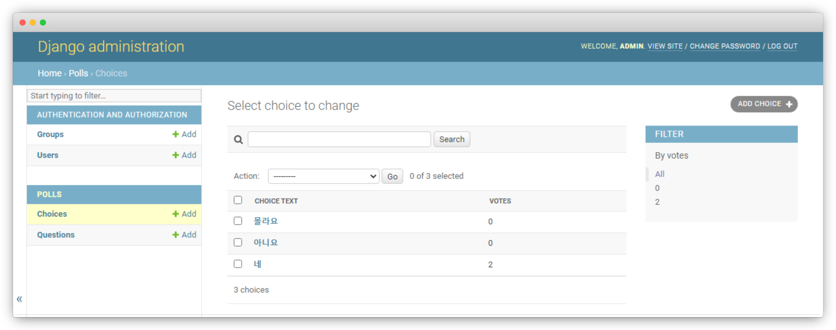
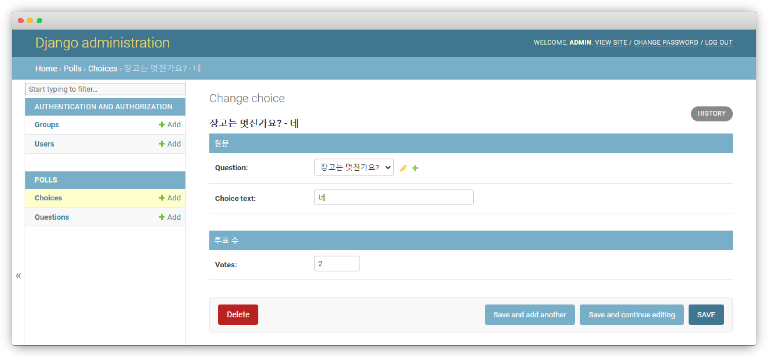
실습1
localhost/admin

Slide 15
모델
python manage.py makemigrations
python manage.py migrate

Slide 16
모델
CRUD

Slide 17
모델
helloworld/polls/views.py
Read
Delete
Create
Update
get_object_or_404(Question, pk=question_id)
question.delete()
question.save()

Slide 18
템플릿
템플릿 변수
{{ var }}

Slide 19
템플릿
템플릿 필터
{{ var|filter:args }}

Slide 20
템플릿
템플릿 필터
{{ name|lower }}

Slide 21
템플릿
템플릿 필터
lower - 소문자화
truncatewords -자름
join – 리스트 join
default - 기본값
length - 길이
striptags - 이스케이프
pluralize – 복수접미사
add - 더하기
center - 중앙정렬
slice - 자르기
pprint - 디버깅
time - 시간
…

Slide 22
템플릿
템플릿 태그
{% tag %}

Slide 23
템플릿
템플릿 태그
{% for 원소 in 리스트 %}
…
{% endfor %}
forloop.couter – 반복횟수(1부터)
forloop.couter0 – 반복횟수(0부터)
forloop.revcouter – 반복횟수 역순
forloop.revcouter0 – 반복역순 0-
forloop.first – 처음
forloop.last – 마지막
forloop.parentloop – 상위 루프

Slide 24
템플릿
템플릿 태그
{% if 조건문 %}
…
{% elif 조건문 %}
…
{% else %}
…
{% endif %}

Slide 25
템플릿
템플릿 태그
{% csrf_token %}

Slide 26
템플릿
템플릿 태그
{% url ‘링크’ 파라미터 %}

Slide 27
템플릿
템플릿 태그
{% with 변수=실행식 %}
… {{변수}} …
{% endwith %}

Slide 28
템플릿
템플릿 태그
{# 주석 #}
{% comment %}
여러줄 주석
{% endcomment %}

Slide 29
템플릿
템플릿 상속
{% block 이름 %}
내용
{% endblock %}
{% extends “파일이름” %}

Slide 30
템플릿
helloworld/polls/templates/polls/layout.html
<!DOCTYPE html> <html lang=“ko"> <head> <meta charset="UTF-8"> <title>투표</title> </head> <body> <h1>{% block title %}투표{% endblock %}</h1> <hr> {% block content %} {% endblock %} </body> </html>

Slide 31
템플릿
helloworld/polls/templates/polls/index.html
{% extends "polls/layout.html" %} {% block content %}
…
{% endblock%}

Slide 32
템플릿
helloworld/polls/templates/polls/detail.html
{% extends "polls/layout.html" %}
{% block title %}질문 : {{question.question_text}}{% endblock %}} {% block content %}
…
{% endblock%}

Slide 33
템플릿
helloworld/polls/templates/polls/results.html
{% extends "polls/layout.html" %} {% block title %}{{question.question_text}} - 결과{% endblock %}} {% block content %}
…
{% endblock%}

Slide 34
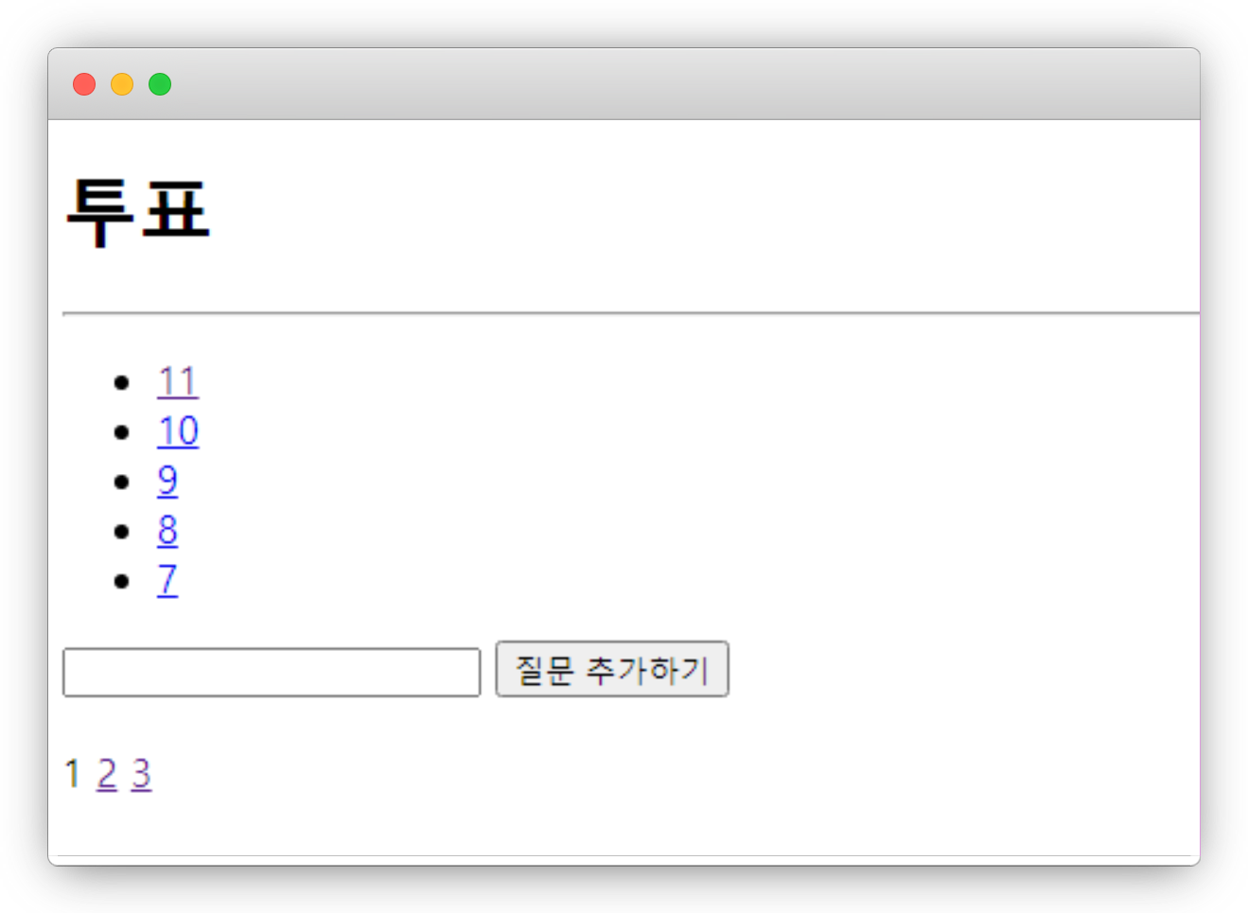
템플릿
localhost/polls

Slide 35
뷰
함수형 뷰
클래스형 뷰

Slide 36
뷰
helloworld/polls/views.py
def index(request): page = int(request.GET.get('page', 1)) lastest_question_list = Question.objects.all().order_by('-pub_date')[page * 5 - 5:][:5] return render(request, 'polls/index.html', {'lastest_question_list': lastest_question_list})

Slide 37
뷰
helloworld/polls/views.py
get_object_or_404

Slide 38
뷰
helloworld/polls/views.py
class.objects.all()

Slide 39
뷰
helloworld/polls/views.py
var.???_set.all()

Slide 40
뷰
helloworld/polls/views.py
HttpResponseRedirect

Slide 41
뷰
helloworld/polls/views.py
render

Slide 42
실습2
polls 앱 꾸며보기!

Slide 43
실습2
helloworld/polls/templates/polls/layout.html
<head> <meta charset="UTF-8"> <title>투표</title> {% load static %} <link rel="stylesheet" type="text/css" href="{% static 'polls/style.css' %}"> </head>

Slide 44
실습2
helloworld/polls/static/polls/style.css
<style> 태그 안의 내용 여기에 작성!

Slide 45
실습2
서버 재시작

Slide 46
blog
함수형 뷰
클래스형 뷰

Slide 47
blog
Post
id
integer, AutoIncrement, PK
content
TextField, 내용
title
varchar(50), 제목
create_dt
dateTimeField, 작성일자
slug
Slug, unique, 주소
modify_dt
dateTimeField, 수정일자
description
varchar(100), 부제목

Slide 48
blog
helloworld/blog/models.py
from django.db import models from django.urls import reverse class Post(models.Model): title = models.CharField('제목', max_length=50) slug = models.SlugField('슬러그', allow_unicode=True, unique=True) description = models.CharField('설명', max_length=100, blank=True) content = models.TextField('내용') create_dt = models.DateTimeField('작성일', auto_now_add=True) modify_dt = models.DateTimeField('수정일', auto_now=True)

Slide 49
blog
helloworld/blog/models.py
class Post(models.Model): def __str__(self): return self.title def get_absolute_url(self): return reverse('blog:post_detail', args=(self.slug,)) def get_previous(self): return self.get_previous_by_modify_dt()

Slide 50
blog
helloworld/blog/models.py
class Post(models.Model): class Meta: verbose_name = '게시글' verbose_name_plural = '게시글' db_table = 'blog_post' ordering = ['-modify_dt']

Slide 51
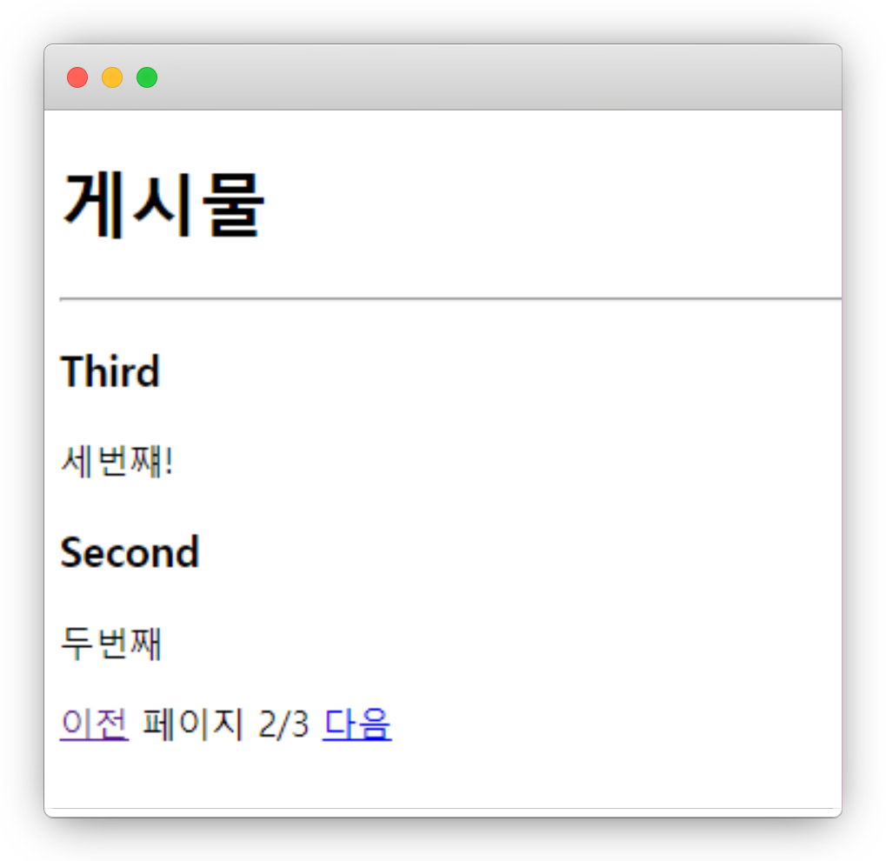
blog
localhost/blog

Slide 52
blog
helloworld/blog/urls.py
from django.urls import path, re_path from . import views urlpatterns = [ path('', views.PostLV.as_view(), name='index'), re_path(r'^post/(?P<slug>[-\w]+)/$', views.PostDV.as_view(), name='post_detail'), ]
app_name = 'blog'

Slide 53
blog
helloworld/blog/views.py
from django.views.generic import ListView, DetailView from blog.models import Post class PostDV(DetailView): model = Post template_name = 'blog/post_detail.html' context_object_name = 'post'

Slide 54
blog
helloworld/blog/templates/blog/post_list.html
<h1>게시물</h1> <hr> {% for post in posts %} <a href=“{{post.get_absolute_url}}”><h3>{{post.title}}</h3></a> <p>{{post.description}}</p> {% endfor %}

Slide 55
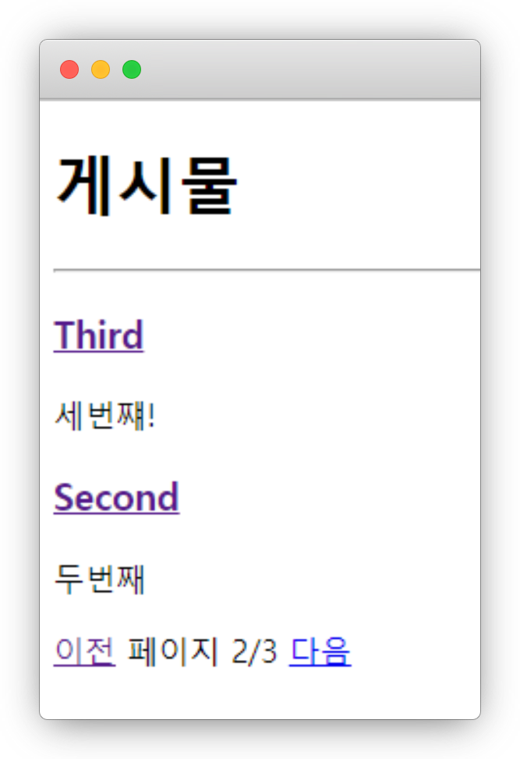
blog
localhost/blog

Slide 56
blog
helloworld/blog/templates/blog/post_detail.html
<h2>{{post.title}}</h2> <h3>{{post.description}}</h3> <span>작성일자 : {{post.modify_dt|date:"Y F j"}}</span> <div> {{post.content|linebreaks}} </div> {% if object.get_previous %} <a href="{{post.get_previous.get_absolute_url}}">이전 : {{object.get_previous}}</a> <br> {% endif %} {% if object.get_next %} <a href="{{post.get_next.get_absolute_url}}">다음 : {{object.get_next}}</a> {% endif %}

Slide 57
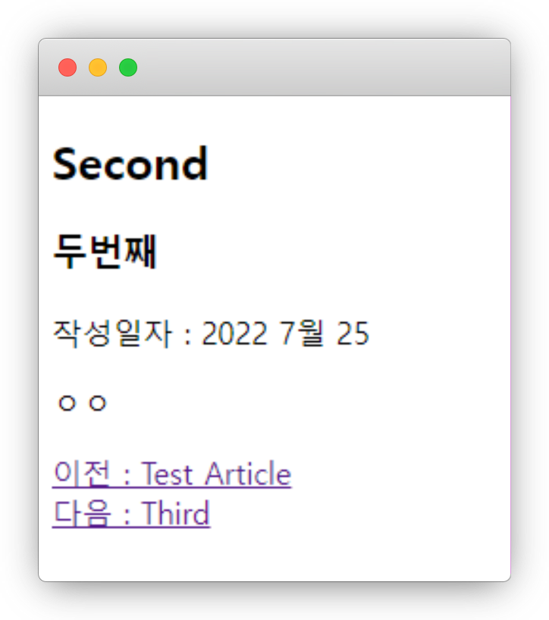
blog
localhost/blog

Slide 58
제네릭 뷰
클래스 -> 상속 가능!
장고에서 지원하는 내장 뷰
ListView, DetailView, …

Slide 59
제네릭 뷰
ListView – 객체의 리스트를 보여주는 뷰
DetailView – 객체 하나를 보여주는 뷰
RedirectView – 리다이렉트를 해주는 뷰
TemplateView – 단순 렌더링을 해주는 뷰

Slide 60
제네릭 뷰
FormView – 수정 폼을 보여주는 뷰
CreateView – 생성 뷰
UpdateView – 수정 뷰
DeleteView – 삭제 뷰

Slide 61
실습3
polls -> 클래스형 뷰

Slide 62
실습4
댓글 모델 구현!

Slide 63
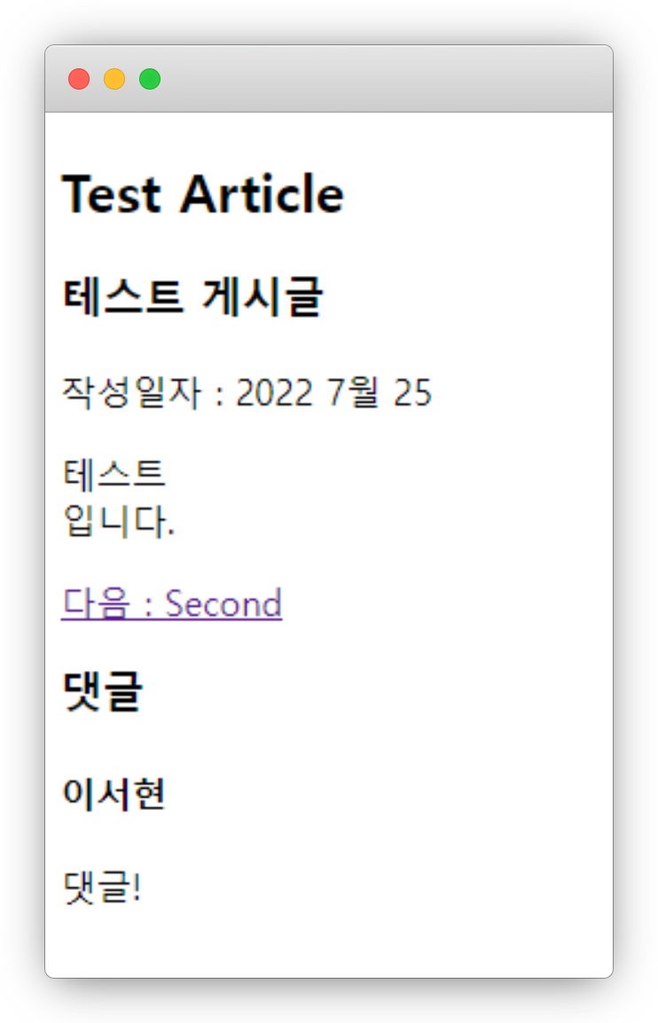
실습4

Slide 64
실습4
Comment
id
integer, AutoIncrement, PK
???
???
???
???

Slide 65
실습4
Comment
id
integer, AutoIncrement, PK
content
TextField, 내용
post
Post(Foerign Key), 달린 글
create_dt
dateTimeField, 작성일자
writer
varchar(50), 작성자

Slide 66
실습4
python manage.py makemigrations
python manage.py migrate

Slide 67
blog
helloworld/blog/models.py
class CommentAdd(CreateView): model = Comment fields = ['writer', 'content', 'post'] def get_success_url(self): return reverse('blog:post_detail', kwargs={'slug': self.object.post.slug})

Slide 68
blog
helloworld/blog/urls.py
path('comment/', views.CommentAdd.as_view(), name='comment'),

Slide 69
blog
helloworld/blog/templates/blog/post_detail.html
<form action="{% url 'blog:comment' %}" method="post"> {% csrf_token %} <input type="hidden" name="post" value="{{post.slug}}"> <input type="text" name="writer" placeholder="작성자"> <textarea name="content" placeholder="내용"></textarea> <input type="submit" value="댓글작성"> </form>

Slide 70
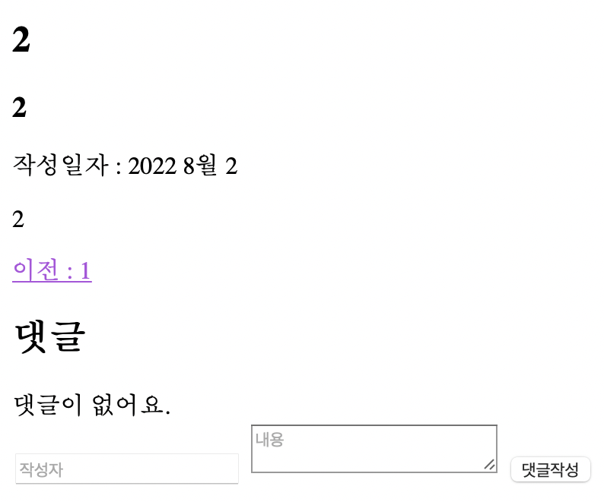
blog
localhost/blog/post

Slide 71
blog
helloworld/blog/views.py
class PostLV(ListView):
def get_queryset(self, *args, **kwargs): qs = super().get_queryset(*args, **kwargs) query = self.request.GET.get('q') if query: return qs.filter(title=query) return qs

Slide 72
blog
helloworld/blog/views.py
class PostLV(ListView):
def get_context_data(self, **kwargs): context = super(PostLV, self).get_context_data(**kwargs) if self.request.GET.get('q'): context['q'] = self.request.GET.get('q') return context

Slide 73
blog
helloworld/blog/templates/blog/post_list.html
<form method="get"> <input type="text" name="q" value="{{q}}"> <input type="submit" value="검색"> </form>

Slide 74
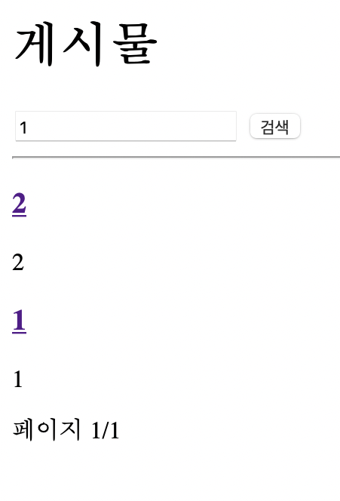
blog
localhost/blog

Slide 75
실습5
polls -> 클래스형 뷰

Slide 76

부트스트랩

Slide 77
부트스트랩
https://getbootstrap.kr/docs/5.0/getting-started/introduction/

Slide 78
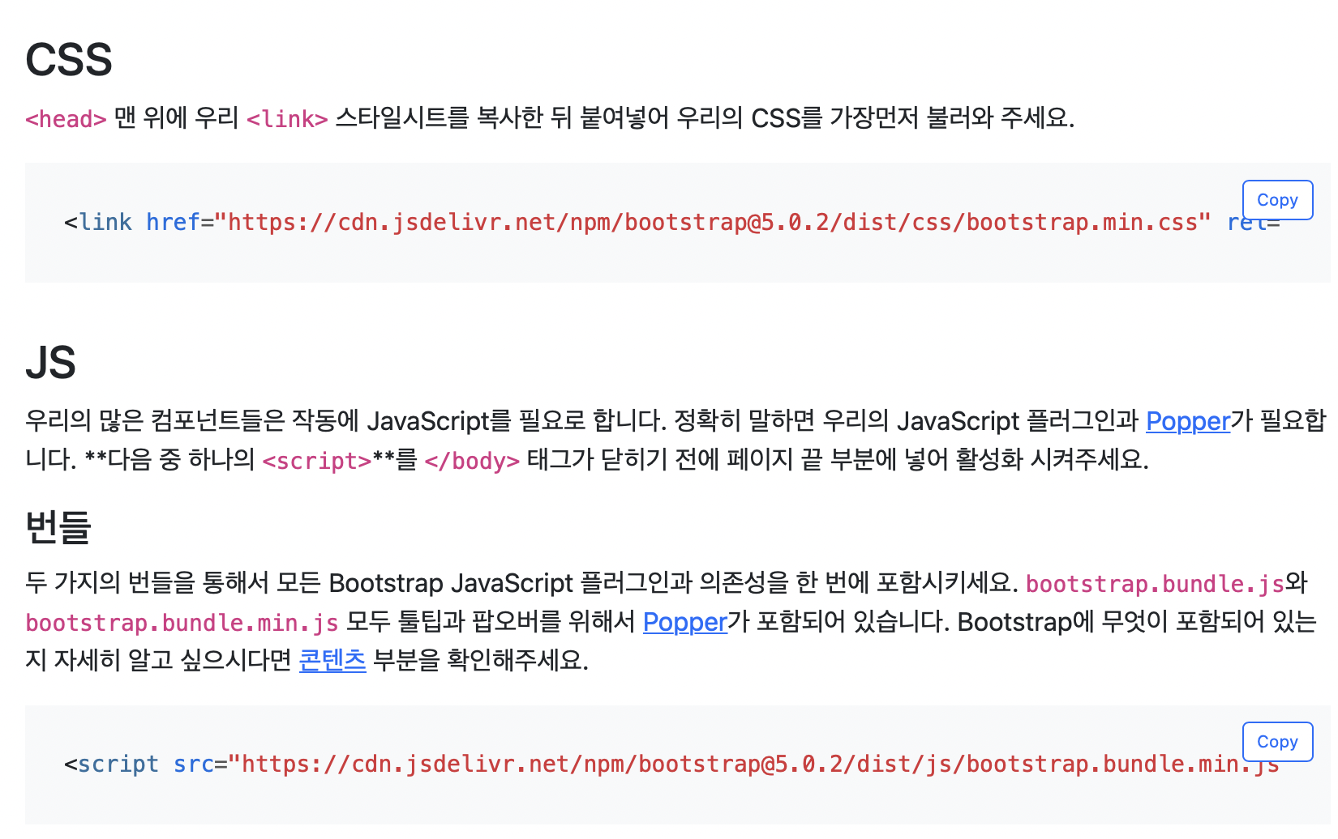
부트스트랩

Slide 79
부트스트랩
<nav class="navbar navbar-expand-lg navbar-light bg-light"> <div class="container-fluid"> <a class="navbar-brand" href="#">상단바</a> <button class="navbar-toggler" type="button" data-bs-toggle="collapse" data-bs-target="#navbarSupportedContent" aria-controls="navbarSupportedContent" aria-expanded="false" aria-label="Toggle navigation"> <span class="navbar-toggler-icon"></span> </button> <div class="collapse navbar-collapse" id="navbarSupportedContent"> <ul class="navbar-nav me-auto mb-2 mb-lg-0"> <li class="nav-item"> <a class="nav-link active" aria-current="page" href="#">메뉴</a> </li> <li class="nav-item dropdown"> <a class="nav-link dropdown-toggle" href="#" id="navbarDropdown" role="button" data-bs-toggle="dropdown" aria-expanded="false">드롭다운</a> <ul class="dropdown-menu" aria-labelledby="navbarDropdown"> <li><a class="dropdown-item" href="#">메뉴</a></li> </ul> </li> </ul> <form class="d-flex"> <input class="form-control me-2" type="search" placeholder="내용" aria-label="Search"> <button class="btn btn-outline-success" type="submit">Search</button> </form> </div> </div> </nav>

Slide 80
부트스트랩
<h1>버튼</h1> <button type="button" class="btn btn-primary">버튼</button> <button type="button" class="btn btn-secondary">버튼</button> <button type="button" class="btn btn-success">완료</button> <button type="button" class="btn btn-danger">경고</button> <h1>입력</h1> <label for="form1" class="form-label">이메일</label> <input type="email" class="form-control" id="form1" placeholder="name@example.com">

Slide 81
부트스트랩
<h1>알림</h1> <div class="alert alert-primary" role="alert">알림</div> <div class="alert alert-secondary" role="alert">알림</div> <div class="alert alert-success" role="alert">성공</div> <div class="alert alert-danger" role="alert">경고</div> <h1>페이징</h1> <nav aria-label="breadcrumb"> <ol class="breadcrumb"> <li class="breadcrumb-item"><a href="#">홈</a></li> <li class="breadcrumb-item"><a href="#">투표</a></li> <li class="breadcrumb-item active" aria-current="page">테스트</li> </ol> </nav>

Slide 82
부트스트랩
<h1>리스트</h1> <ul class="list-group"> <li class="list-group-item">1번</li> <li class="list-group-item">2번</li> <li class="list-group-item">3번</li> </ul> <h1>페이지</h1> <nav aria-label="Page navigation"> <ul class="pagination"> <li class="page-item"><a class="page-link" href="#">이전</a></li> <li class="page-item"><a class="page-link" href="#">1</a></li> <li class="page-item"><a class="page-link" href="#">2</a></li> <li class="page-item"><a class="page-link" href="#">3</a></li> <li class="page-item"><a class="page-link" href="#">다음</a></li> </ul> </nav> <h1>프로그레스</h1> <div class="progress"> <div class="progress-bar" role="progressbar" style="width: 25%" aria-valuenow="25" aria-valuemin="0" aria-valuemax="100"></div> </div>

Slide 83
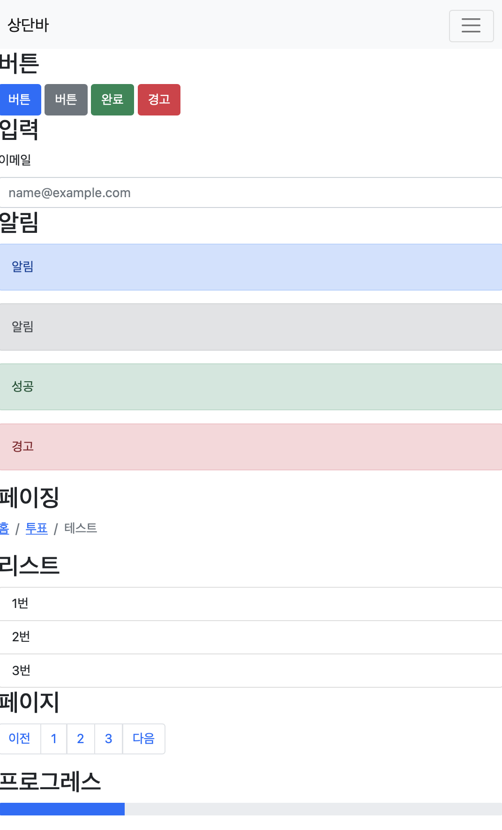
부트스트랩

Slide 84
실습6
blog에 부트스트랩 적용

Slide 85
다음 시간에는…
자바스크립트

Slide 86
웹 프로그래밍
한글과컴퓨터학원
조교 이서현

